Slide 1

War: The Card Game
Created by: Sarah Hantz, Hannah Myers, Gabriel Cisneros, and Arica Hyman

Slide 2

What is “War: The Card Game” about?
Players start the game with 16 cards facedown. They both ( a user and a bot) turn over their top cards at the same time, in which the player with the highest card wins the round. If the cards are the equal, players then turn their next card and the winner takes all four cards. In the end the player who has all the cards wins!

Slide 3

Our User Story
As web development students, we wanted a fun yet simple game that we could have fun playing against a Bot. We found inspiration from Hannah who got the idea from playing cards with her fiance, and as a group we found the idea exciting and enjoyable.

Slide 4
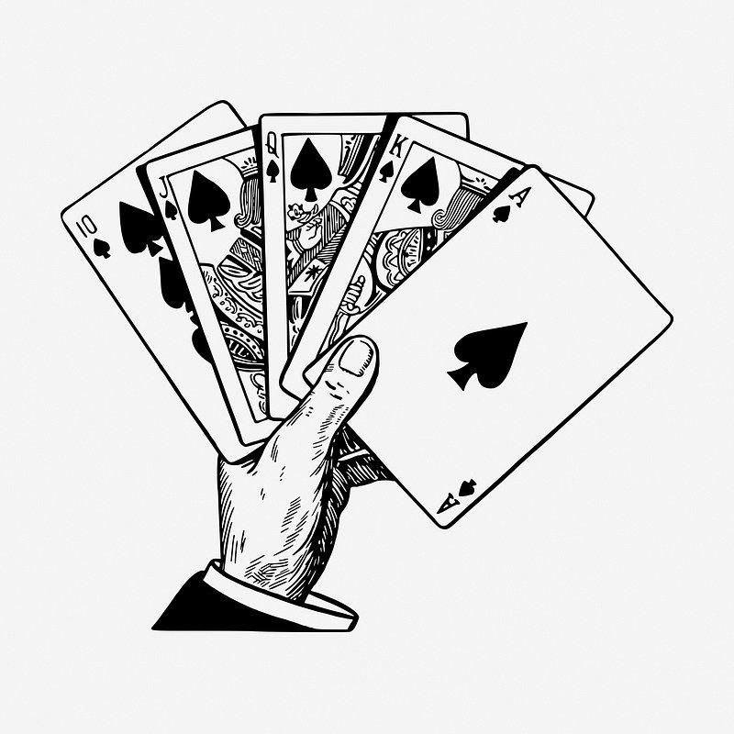
What was our process?
Some technologies used in the project were GitHub, VS, AI and google.
We broke the roles down in a way so we were all doing things we were comfortable with but also fair in size or worth.
Some challenges that we encountered were getting everything pushed and pulled in github and linking the java and html codes together
We succeeded in many ways, such as working well together, asking questions when needed, having the ability of troubleshooting when necessary, and having an team

Slide 5
Let’s see what our project is about!
Demo: Show your stuff!

Slide 6
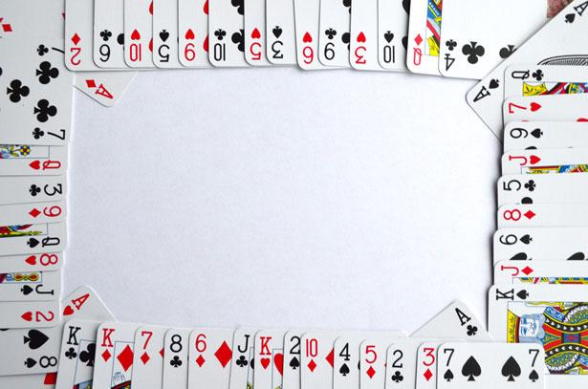
Future development
Directions for Future Development for our application would be to put ads in our game to monetize it, probably add more players to the game, make it so you can share the link with more people to play with, and make it an online game so they can play online with other people.

Slide 7
Links to GitHub and Applications
GitHub https://github.com/selhz9/Class-Project-1/tree/main
Web Page

